Slide 1
RNN and LSTM
PRESENTED BY Donguk Shin, Chenwei Wu, Cheng-Yun Tsai
11/15/2022
Notes:
Today we’re going to talk about RNN and LSTM model.
This presentation is structured as follows.
First, I’ll introduce basic concept of RNN.
Next, Chenwei will talk about LSTM.
Lastly, Cheng-Yun will compare RNN and LSTM.

Slide 2
Recurrent Neural Network (RNN)
01

Slide 3
What is RNN?
Recurrent Neural Networks(RNNs) are a type of Neural Network that allow previous output to be used as input while having hidden states
RNN save the previous output of a particular layer and feed this back to the input in order to predict the output of the layer.
Used for language translation, natural language processing (nlp), and time series prediction

Slide 4
Why RNN?
Feed-Forward Neural Network :
Cannot handle sequential data
Considers only the current input
Cannot memorize previous inputs
RNN solves these issues:
can handle sequential data
accepts the current input data and previously received inputs
can memorize previous inputs
Notes:
So why RNN?
While traditional deep neural networks assume that inputs and outputs are independent of each other,
the output of recurrent neural networks depend on the prior elements within the sequence.

Slide 5
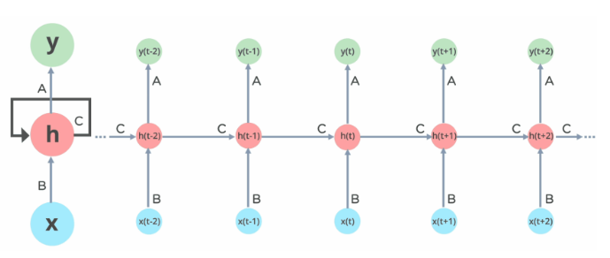
Architecture of RNN
Notes:
Here’s architecture of RNN
Here, “x” is the input layer, “h” is the hidden layer, and “y” is the output layer.
The input layer ‘x’ takes in the input to the neural network and processes it and passes it onto the middle layer. At any given time t, the current input is a combination of input at x(t) and x(t-1).
The middle layer ‘h’ can consist of multiple hidden layers, each has own activation functions and weights and biases.
The RNN will standardize the different activation functions and weights and biases so that each hidden layer has the same parameters.

Slide 6
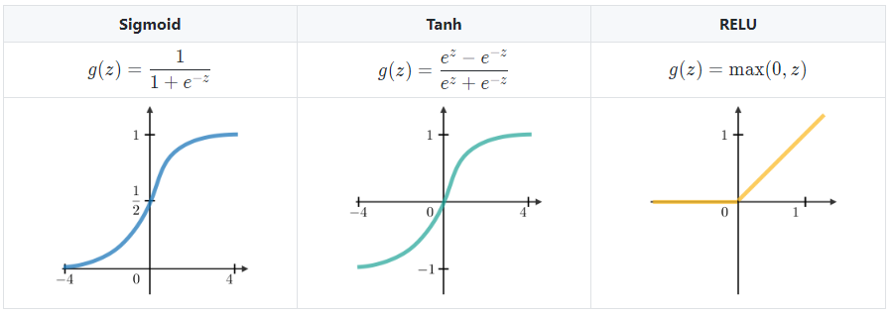
Common Activation functions
Notes:
These three functions are commonly used activation functions.
an activation function determines whether a neuron should be activated.
The nonlinear functions typically convert the output of a given neuron to a value between 0 and 1 or -1 and 1.

Slide 7
Pros and Cons
Pros
Process input of any length
Model size not increase with size of input
Remember historical information which is useful for time series prediction
Cons
Gradient vanishing and exploding problems.
Training an RNN is a very difficult task.
Difficult to access information from a long time ago
Notes:
RNN is hard to train because of the gradient problem.
Difficult to capture long term dependencies because of multiplicative gradient that can be exponentially decreasing/increasing with respect to the number of layers
Now, let’s discuss the most popular and efficient way to deal with gradient problems, i.e., Long Short-Term Memory Network (LSTMs).

Slide 8
Long Short-Term Memory (LSTM)
02

Slide 9
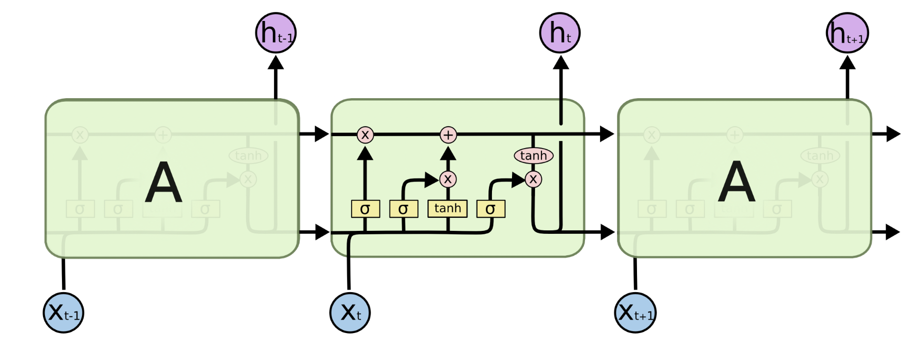
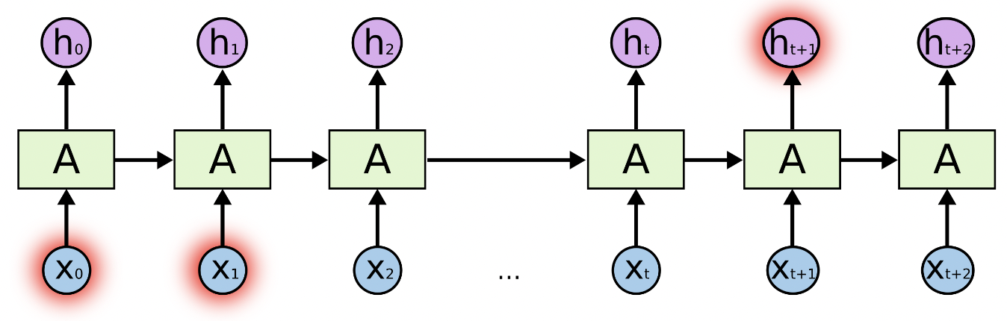
2. Long short-term memory(LSTM)
When training the traditional RNN using back-propagation, the long-term gradients which are back-propagated can vanish or explode, making it difficult to handle a long sequences of data.
LSTM model is a special type of RNN that has both "long-term memory" and "short-term memory”. Its architecture allows each cell to remember values over arbitrary time intervals and regulate the flow of information into and out of the cell. And this model was developed to deal with the vanishing gradient problem

Slide 10
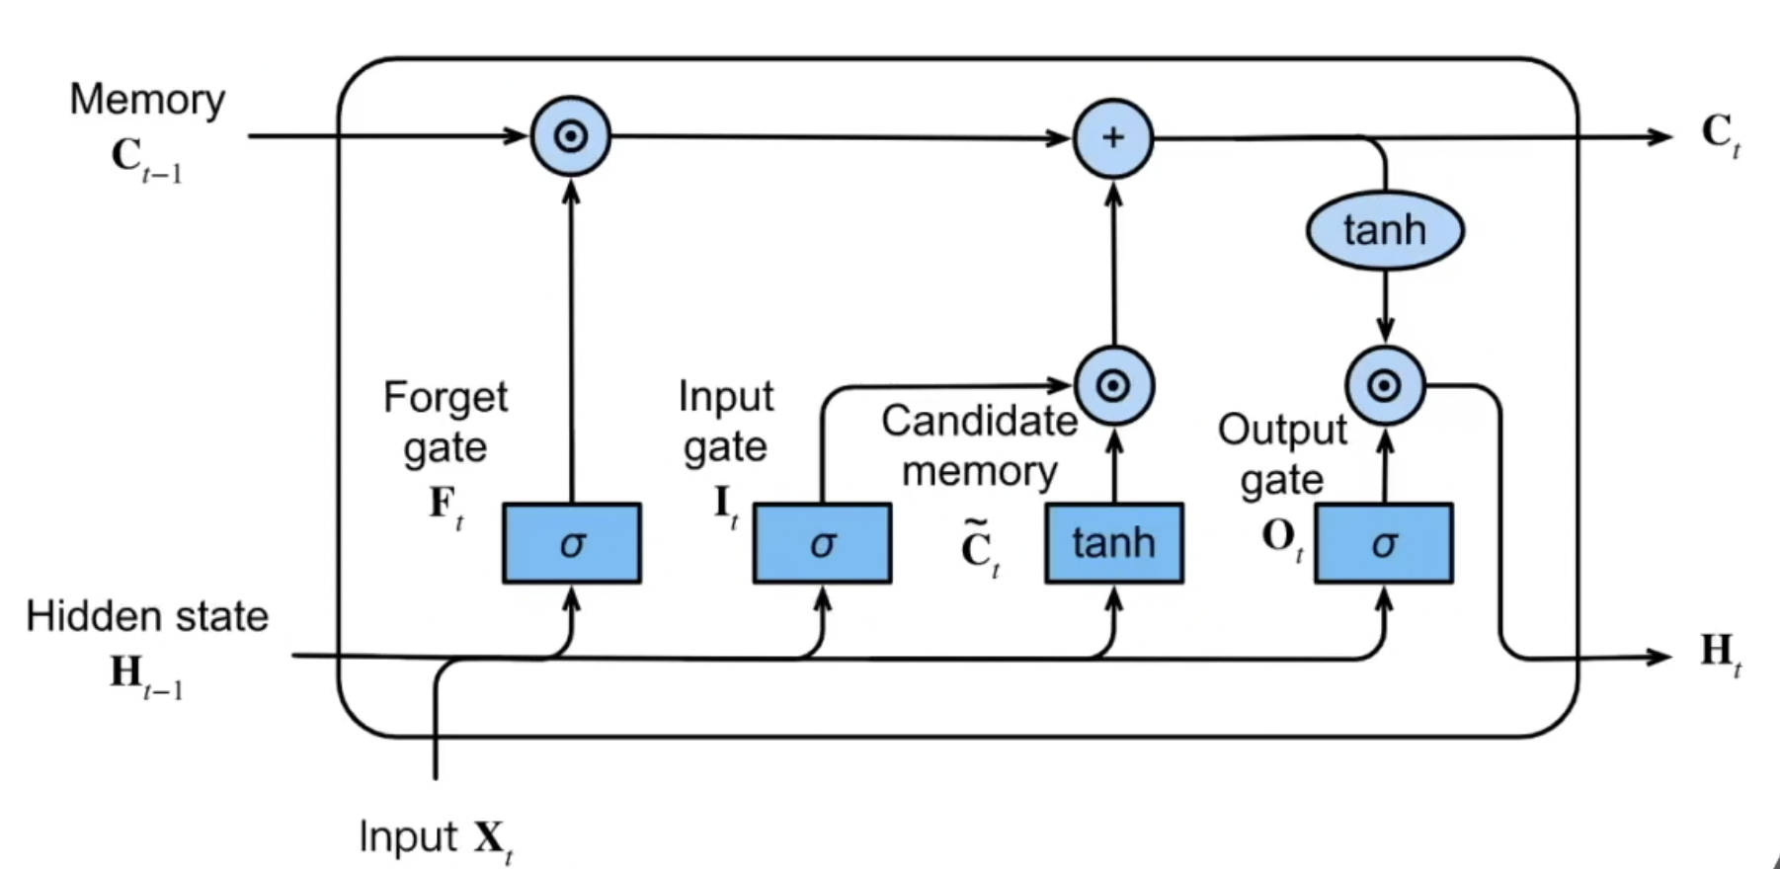
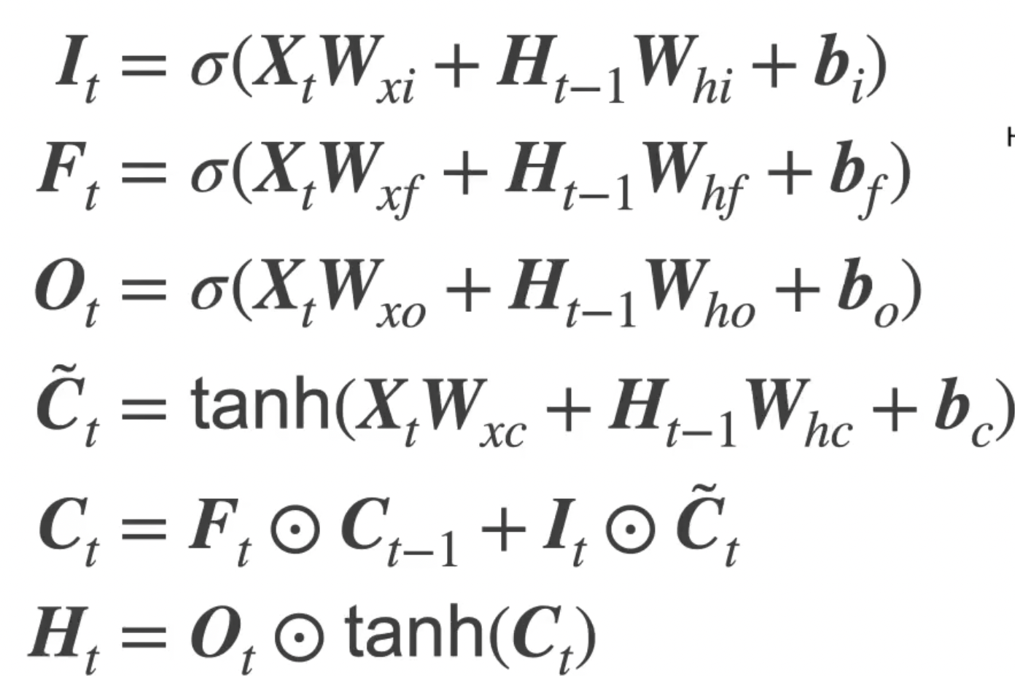
2. Long short-term memory(LSTM)
A common LSTM unit is composed of a cell, three gates, and two hidden states.
The first step is to decide what information we’re going to throw. This decision is made by a sigmoid layer called the “forget gate.”
The next step is to decide what new information we’re going to store in the cell state. This is achieved by two parts, “input gate” and “candidate memory”.
Finally, we need to decide what we’re going to output. This is based on the new memory state and another sigmoid layer called “output gate”.

Slide 11
RNN vs. LSTM
03

Slide 12
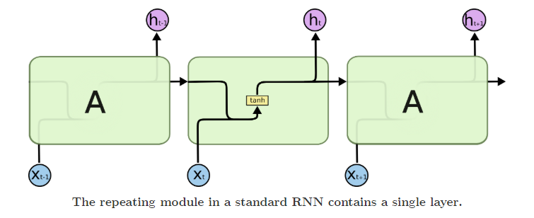
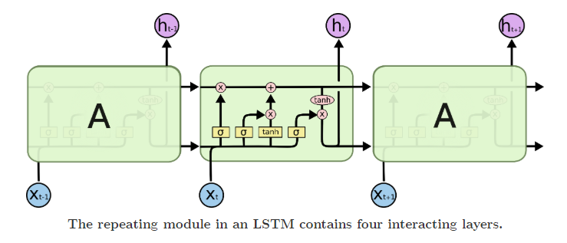
RNN and LSTM
Recurrent Neural Network is a generalization of feedforward neural network that has an internal memory.
Simple RNN cannot process very long sequences because the gradient of the loss function decays exponentially with time.
LSTM model is a special type of RNN (Gated Recurrent Neural Networks) which enables RNNs to remember inputs over a long period of time.

Slide 13
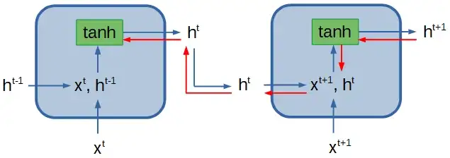
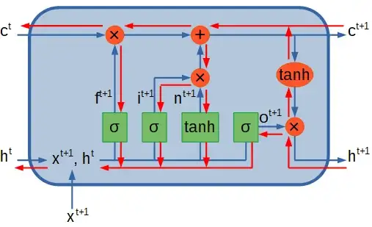
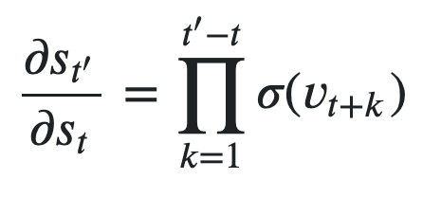
Vanishing and Exploding Gradient Problem
Everytime we go back a time step, we need to make an inner product between our current gradient and the weight matrix.
Vanishing gradient issue for 0.9:
0.9¹⁰⁰ = 0.000017…
For the LSTM, there's is a set of weights which can be learned such that
𝜎(⋅) ≈ 1
Notes:
The feed forward calculations use the same set of parameters (weight and bias) in all time steps.

Slide 14
Types of RNN in Keras
GRU
(Gated Recurrent Unit)
SimpleRNN
LSTM
A fully-connected RNN where the output from previous timestep is to be fed to next timestep.
First proposed in Cho et al., 2014.
Computationally easier than LSTM ( GRU only has 2 gates).
Similar performance with LSTM and more efficient (less parameters).
First proposed in Hochreiter & Schmidhuber, 1997.

Slide 15
References
https://www.simplilearn.com/tutorials/deep-learning-tutorial/rnn
https://stanford.edu/~shervine/teaching/cs-230/cheatsheet-recurrent-neural-networks
https://en.wikipedia.org/wiki/Long_short-term_memory
https://colah.github.io/posts/2015-08-Understanding-LSTMs/
https://d2l.ai/chapter_recurrent-modern/lstm.html
Notes:
The feed forward calculations use the same set of parameters (weight and bias) in all time steps.

